Slide 1
Welcome!
We will begin the webinar in a few minutes.
Feel free to use the chat room to speak with other attendees.

Slide 2
Understanding Research Metrics:
What Really Matters?
Dr. Avriel Licciardi & Dr. Clark Holdsworth

Slide 3
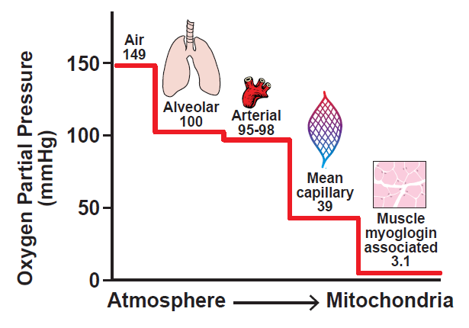
About the speakers
Dr. Clark Holdsworth
Senior Manager, Communications & Partnerships
LetPub
Doctorate, Physiology
3

Slide 4
About the speakers
Dr. Avriel Licciardi
Research Communications Strategist
LetPub
M.S. Geology
Ph.D. Geological Sciences
4

Slide 5
Today’s Topic: Understanding Research Metrics
Why are Citations Important?
Common Databases
Journal-level vs. Article-level vs. Author-level metrics
Making Metrics Work for You
Q & A
5

Slide 6
Webinar Motivation
Research metrics are commonly used as a benchmark for assessing scholarly impact.
Citation metrics are considered (by some) as efficient and reliable indicators of quality at the journal, article, and author levels.
… but these metrics are not comprehensive, have limitations, and can be biased.
Necessary for researchers to understand these metrics to successfully meet their personal research and career goals.

Slide 7
The Basics
What are citations?
Formal reference to the source of information (published or unpublished)
Indicates citing author has referred to a part of or full information in the established literature
Key components: author, date, title, publication details
In-text citation and end of manuscript reference

Slide 8
The Basics
Why are citations important?
Uphold intellectual honesty
Attributes prior work to the correct sources
Help readers locate the source of information
Enable readers to independently assess the referenced material
Facilitate replication and validation of the published work

Slide 9
What is citation analysis?
Analysis of the impact, influence, relative importance and presumed quality of publications
Enumeration of the number of times a publication has been referred to (i.e., cited) by other researchers or in other works
Quantitative measure of the impact of a publication, an author, a journal, an institute, etc.

Slide 10
Why is citation analysis so important in academia?

Slide 11
Impact of Citations: Researchers
Conducting research & publishing
Reading, citing, and learning prior research is essential to conducting work
Establishing where your research stands within your field is critical for novelty
Demonstrating grant progress / impact / attracting funding
Publishing shows progress to funders (and application)
Seeing projects to completion attracts additional funding (illustrates you are successful in research plan)
Receiving credit & career advancement
Citations allow you to showcase your work
Citations included in CV, applications

Slide 12
Impact of Citations: Journals
Ensures accuracy of presented work
Citations reflect published (and presumably vetted) scientific literature
Avoids plagiarism
Way to assess journal performance over time
Used to rank journals in disciplines and globally
Attract new submissions
Higher metrics = more submissions

Slide 13
Databases

Slide 14
Common Databases

Slide 15
Common Databases
Multidisciplinary database with broad scientific coverage
Provides most well-known and frequently used metrics (i.e., Impact Factor, JCR, h-index)
Moderate coverage of HSS
Mainly English language journals

Slide 16
Common Databases
Multidisciplinary database with broad scientific coverage
Provides most well-known and frequently used metrics (i.e., Impact Factor, JCR, h-index)
Moderate coverage of HSS
Mainly English language journals
Multidisciplinary database with broad scientific coverage
SCImago Journal Rank, SNIP, h-index
Covers more OA journals than WoS
Publications mainly English language journals

Slide 17
Common Databases
Multidisciplinary database with broad scientific coverage
Provides most well-known and frequently used metrics (i.e., Impact Factor, JCR, h-index)
Moderate coverage of HSS
Mainly English language journals
Multidisciplinary database with broad scientific coverage
SCImago Journal Rank, SNIP, h-index
Covers more OA journals than WoS
Publications mainly English language journals
Freely available and user friendly
Retrieves information irrespective of language or country
No source details, includes non-peer reviewed articles
Author profile with metrics (h-index, citation number, total paper number, etc.)

Slide 18
Types of Scholarly Metrics

Slide 19
Types of Research Metrics
Journal-level metrics: indicate impact of the journal in community based on citations received by published articles
# of citations received in 2020
CiteScore =
# of documents published in 2017, 2018, 2019
Computes citations from all documents in one year to all documents published in previous three years
Based on Scopus

Slide 20
Types of Research Metrics
Journal-level metrics: indicate impact of the journal in community based on citations received by published articles
Impact Factor
Original purpose: measures relative importance of journal within a specific field or discipline
Never intended to be used to evaluate individual scientists, but misuse has occurred
Uses a two-year period to divide the number of times articles were cited by the number of articles that were published

Slide 21
Types of Research Metrics
Impact Factor (2020) = A / B
A = number of times articles published in 2018 and 2019 were cited by journals indexed in the WoS in 2020
B = total number of “citable items” published in 2018 and 2019
Reflects only on how many citations on a specific journal there are (on average). A journal with a high IF has articles that are cited often.

Slide 22
Types of Research Metrics
Impact Factor considerations:
Numerator counts all citations to all types of publications, while the denominator considers only the number of the “citable documents”.
Some high impact journals publish editorials/news articles, which are highly cited. However, these items are not “citable documents,” leading to overestimation of JIFs.
A recently launched journal cannot have an IF due to the 2-year calculation.
Journals are pressured to increase their JIF, which leads to editorial misconduct.
Journal editors ask authors to include references from the journal’s previous publications

Slide 23
Types of Research Metrics
JIF can be skewed by publication of review papers, which tend to be cited more frequently or by self-citation of articles.
JIFs from different research fields are not comparable due to different field-specific citation habits.

Slide 24
Types of Research Metrics
Article-level metrics: measures that provide information about usage, impact, and reach of individual articles
Incorporates data from traditional (citation-based) and non-traditional (social media) sources
Offer way to disaggregate an individual article’s impact from publication in which it appears

Slide 25
Types of Research Metrics
Altmetrics are an alternative to traditional citation metrics.
Provides score based on the number of times a “research output” has been shared, downloaded, or mentioned.
Colorful donut = summary of online attention received by research output
Score (center) = weighted count of all attention the data has received
https://www.altmetric.com/about-our-data/the-donut-and-score/.

Slide 26
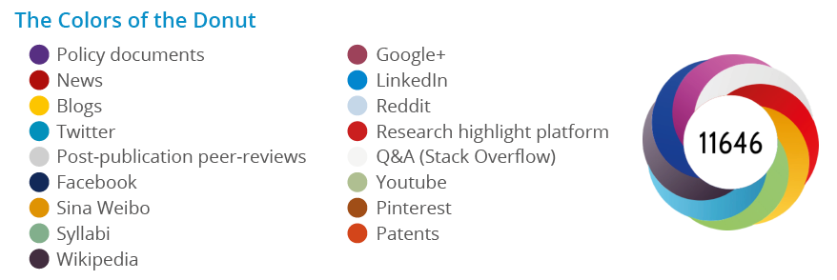
Types of Research Metrics
https://www.altmetric.com/about-our-data/the-donut-and-score/.

Slide 27
Types of Research Metrics
Altmetrics considerations:
Usually calculated by companies, so different sources are included in different company’s calculations
Although a high altmetric score indicates a lot of attention, “attention” doesn’t mean the article is important or even of quality
Useful to use altmetrics with other evaluation metrics

Slide 28
Types of Research Metrics
Author-level metrics: impact of individual author’s publications
Based on total citations received by the articles an individual publishes
h-index; field-weighted citation index; category normalized citation index

Slide 29
Types of Research Metrics
Author-level metrics: impact of individual author’s publications
Hirsch index (h-index) = quantifies the bibliometric impact of individual authors
Productivity evaluated as number of publications
Impact determined by “citation counts”
h-index = number of articles (h) that have been cited at least (h) number of times

Slide 30
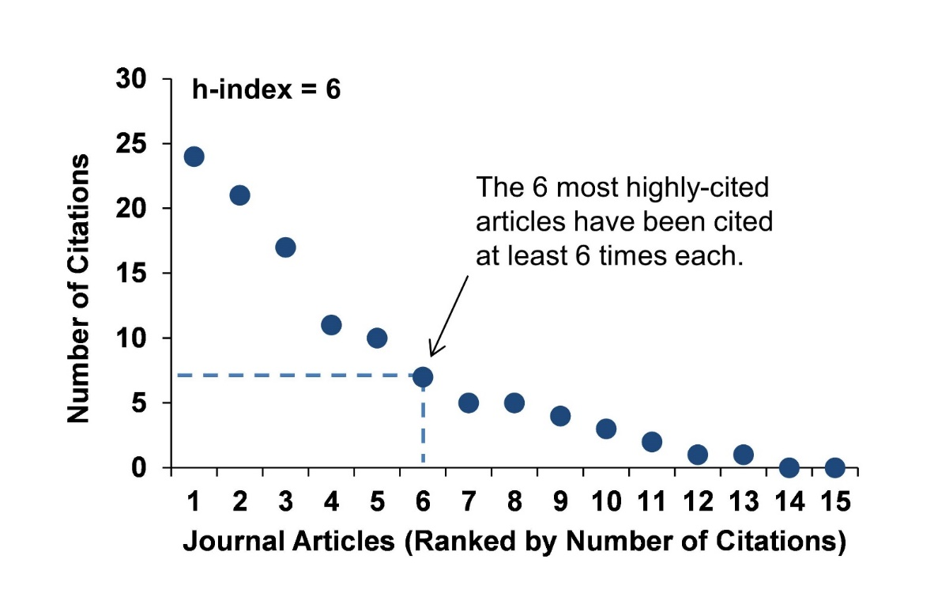
Types of Research Metrics
https://guides.library.illinois.edu/c.php?g=621441&p=4328607
H-index: number of times a publication has been cited is equal to or larger than the line number of the publication.
Articles
1
2
3
4
5
6
7
8
Citation #
35
30
17
11
7
6
3
2
h-index
A publication-based approach for assessing and comparing researchers’ productivity and impact

Slide 31
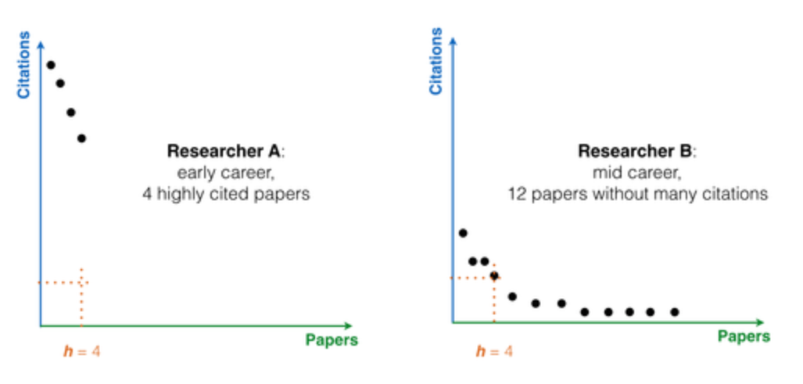
Types of Research Metrics
What h-index doesn’t indicate:
Stage of your career
Whether you were first or tenth author on a high impact publication
Whether citations are due to positive or negative references
Impact factors of the journals you’ve published in
How active you are in the scientific community
https://publons.com/blog/5-things-the-h-index-cant-tell-you/

Slide 32
Types of Research Metrics
H-index considerations:
Varies depending on research discipline
H-index values are higher for popular and high-interest subject areas
Authors who publish in English have better citation indices than authors publishing in other languages
Authors who frequently collaborate and publish together tend to have higher h-indices

Slide 33
Making Metrics Work for You

Slide 34
Trends in Industry
Publishers and funders recognize the widespread misuse of metrics to measure the quality of research.
Funders starting to discourage use of IFs in decisions and instead seek most relevant papers
Policy reforms and recommendations
Journals are removing JIF from their websites
Emergence and support of Altmetrics in scientific assessment
Changing the existing culture will be difficult because the industry has been heavily metrics-based for decades

Slide 35
Making Metrics Work for You
Every database, metric or tool uses different evaluation criteria, parameters, and weightage, in addition to different data sources, context of use, and calculation methods.
Consider what each metric means, and how it should be interpreted in the context of the question you are trying to answer.
Use both qualitative (opinion) and quantitative (metric-based)
input for making decisions.
Use multiple, complementary metrics to assess research impact
and productivity.
Metrics are only a proxy of research quality.

Slide 36
Join us for our next webinar in
March 2021

